Slide 1
SONIC SYNTH
TNCPL030
BY:
GANESAN S
DINESH KUMAR M

Slide 2
Our Mission
Music for Anyone
Music That Gets You
A Space to Be Creative
Exploring New Ground

Slide 3
INNOVATION
From Emojis to Music
Text-Driven Tunes
Mood-Based Composition
Contextual Soundtracks

Slide 4
TECHNICAL APPROACH
FRONTEND:
BACKEND:
PYTHON LIBRARY
HTML
CSS
STREAMLIT
FastAPI, HTTPException,
pydantic
numpy
scipy.io.wavfile
tempfile
csv
os
transformers
pipeline
cached
TTLCache

Slide 5
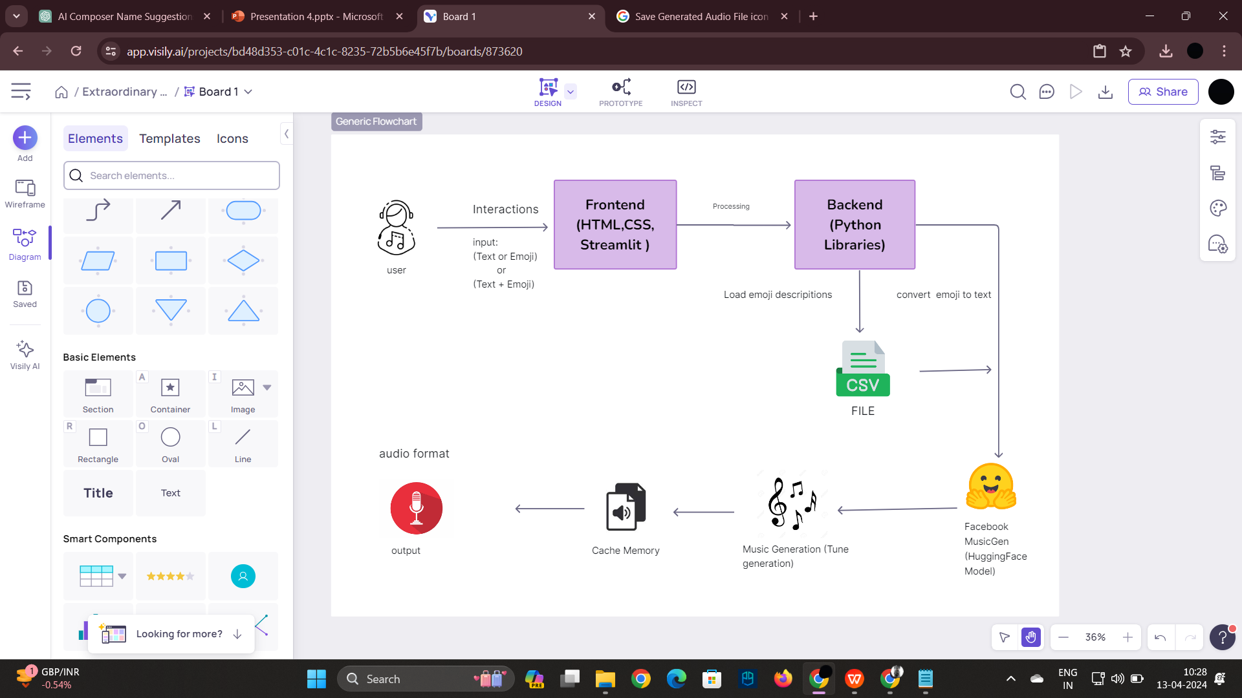
FLOW DIAGRAM

Slide 6
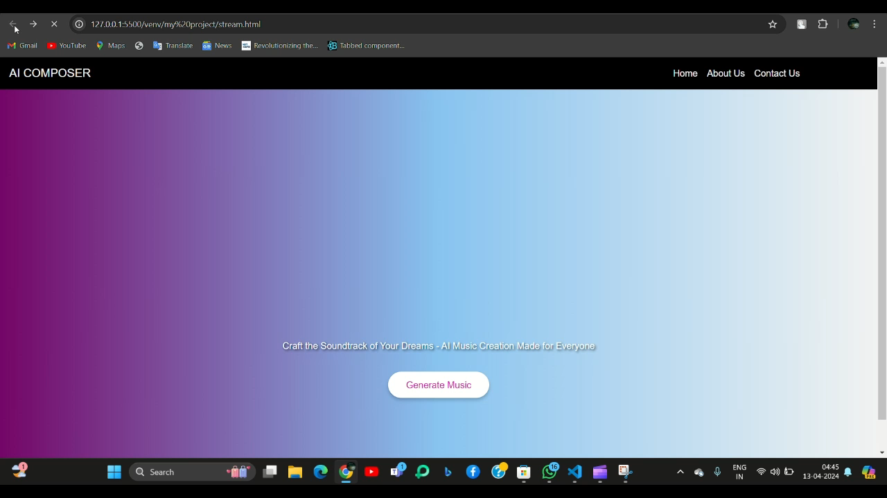
DEMO VIDEO OF AI MUISC COMPOSER

Slide 7
OPPORTUNITIES
Face Image Recognition
Voice Input
Recommendation System

Slide 8
THANK YOU

